Slide 1
Ticket Pricing Model for Big Mountain Resort
Guided Capstone - Springboard
Waruni Wijayasinghe
March 2021

Slide 2
Problem Identification
Big Mountain resort’s current pricing strategy is based on the market average.
Need a more data driven pricing strategy by analyzing facilities and ticket prices of other competitive resorts, by the end of this season.

Slide 3
Problem Identification
Big Mountain Resort is considering a number of changes and want to know how it will be affected for the ticket price and hence the revenue.
1. Permanently closing down 10 of the least used runs.
2. Add a run, increase the vertical drop by 150 feet, and install an additional chairlift.
3. Add a run, increase the vertical drop by 150 feet, install an additional chairlift, and add 2 acres of snow making.
4. Increase the longest run by 0.2 miles and add 4 acres of snow making capability.

Slide 4
Recommendation and findings
Current ticket price is $81. Modeled ticket is $95.87.
Closing 10 runs is not recommended.
Add a run, increase the vertical drop by 150 feet, and install an additional chairlift will increase support for ticket price by $8.61, revenue by $15065471.
Add a run, increase the vertical drop by 150 feet, install an additional chairlift, and add 2 acres of snow making will increase support for ticket price by $9.90, revenue by $17322717.
Increasing the longest run by 0.2 miles and adding 4 acres of snow making capability will make no difference.

Slide 5
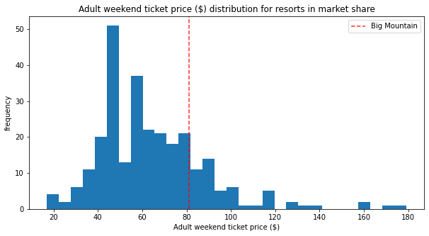
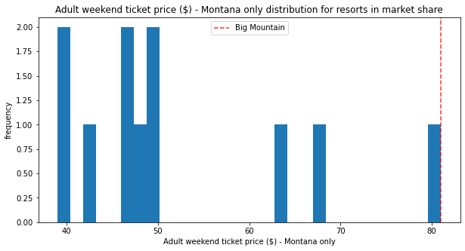
Modeling results and analysis

Slide 6
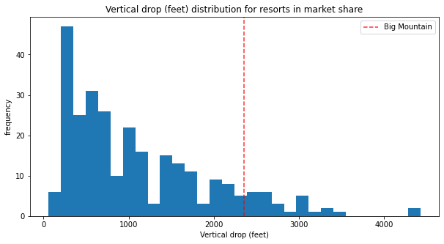
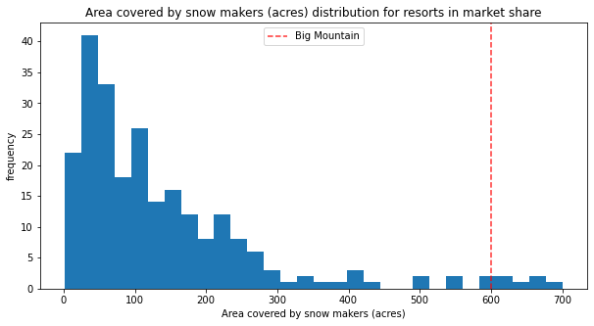
Modeling results and analysis

Slide 7
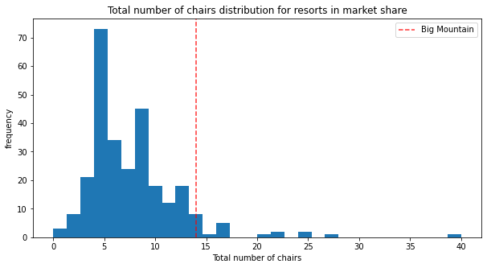
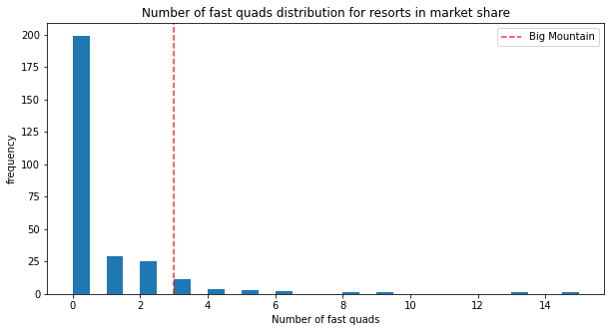
Modeling results and analysis

Slide 8
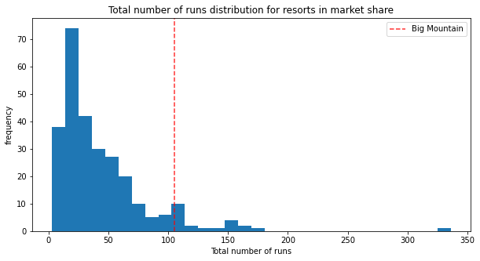
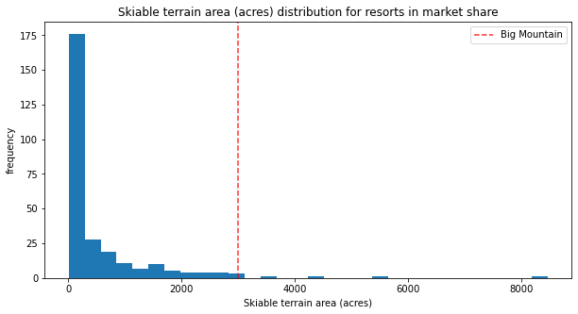
Modeling results and analysis

Slide 9
Summary and conclusion
Ticket price and be increased by $14.87.
Closing down 10 runs will reduce the support for ticket price and so revenue.
Add a run, increase the vertical drop by 150 feet, and install an additional chairlift will support for increase in ticket price. Adding 2 acres of snow making will support more.
Assumptions:
All other resorts set their prices based on how much public value certain facilities.
Different scenarios were tested assuming Blue Mountain has an average of 350000 visitors every year and each buys 5 tickets (for 5 days).

Slide 10
Thank you!

